Slide 1
F I TNESS TRACKER

Slide 2

01/ INTRODUCTION
This PPT presents the design and development of iFit Coach, a fitness tracking mobile application created using Java and Firebase. The app allows users to track their calorie intake, workouts, and water consumption while offering social interaction with other fitness enthusiasts. By integrating features such as goal-setting, personalized metrics, and community engagement, iFit Coach serves as a comprehensive tool for improving health and wellness.

Slide 3


Objectives
Design a user-friendly mobile app
fitness metrics.
for tracking
Integrate social features for community interaction
and professional services.
Ensure secure and real-time Firebase.
Implement a goal-setting and motivate users.
data
storage
using
reward system to
Offer a comprehensive and scalable fitness solution.

Slide 4


System Overview
iFit Coach offers a comprehensive fitness tracking solution that includes features such as
calorie tracking
workout logging
water intake monitoring
goal setting
allows users to connect with others
share content
interact with fitness professionals offering services.

Slide 5

TECHNOLOGIES USED
Java: Used for Android app development.
Firebase: Provides backend services
like
Authentication, Realtime Database, and Cloud Storage.
XML: Used for user interface design.
Third-party libraries: Enhances functionality for features like networking and UI enhancements.

Slide 6





Track daily calorie intake, workouts, and water consumption.
1
2
Set personalized fitness goals and track progress.
3
Engage with a community of fitness enthusiasts through posts and messages.
Access professional fitness services and consultations.
4
5
View detailed nutritional data for various foods.

Slide 7






CLIENT-SIDE (MOBILE APP)
Developed in Java for Android.The app provides a user-friendly interface using XML.
Key Features:
Track daily calories, workouts, water intake.
Set fitness goals.
Engage with community and professionals.
Real-time data synchronization with Firebase.
The app sends data to Firebase, and retrieves updates when necessary.
BORCELLE

Slide 8





Backend (Firebase)
Firebase Authentication: Handles user login and
registration.
Firebase Realtime Database: Stores user data (calories,
workouts, hydration, etc.) and syncs it in real-time.
Firebase Cloud Storage: Stores media files workout images, food pictures).
Firebase Cloud Messaging (FCM): Sends
(e.g.,
push
notifications to engage users and remind them to stay
on track with their goals.

Slide 9

CHALLENGES FACED
Firebase Integration: Ensuring smooth real-time data synchronization and seamless user authentication.
UI/UX Design: Designing a user interface that is both functional and easy to
navigate.
App Performance: Optimizing app performance when handling large data volumes and ensuring fast load times.
Community Features: Building a social network for users to interact, share achievements, and get professional advice.

Slide 10



Future Enhancements
1. 1Integrating AI-driven recommendations for personalized workout and nutrition plans.
Expanding to iOS to reach a wider user base.
Adding support for wearable devices like smartwatches.
Introducing social sharing features to increase community engagement.
Enhancing goal-setting features with automated reminders and challenges.

Slide 11
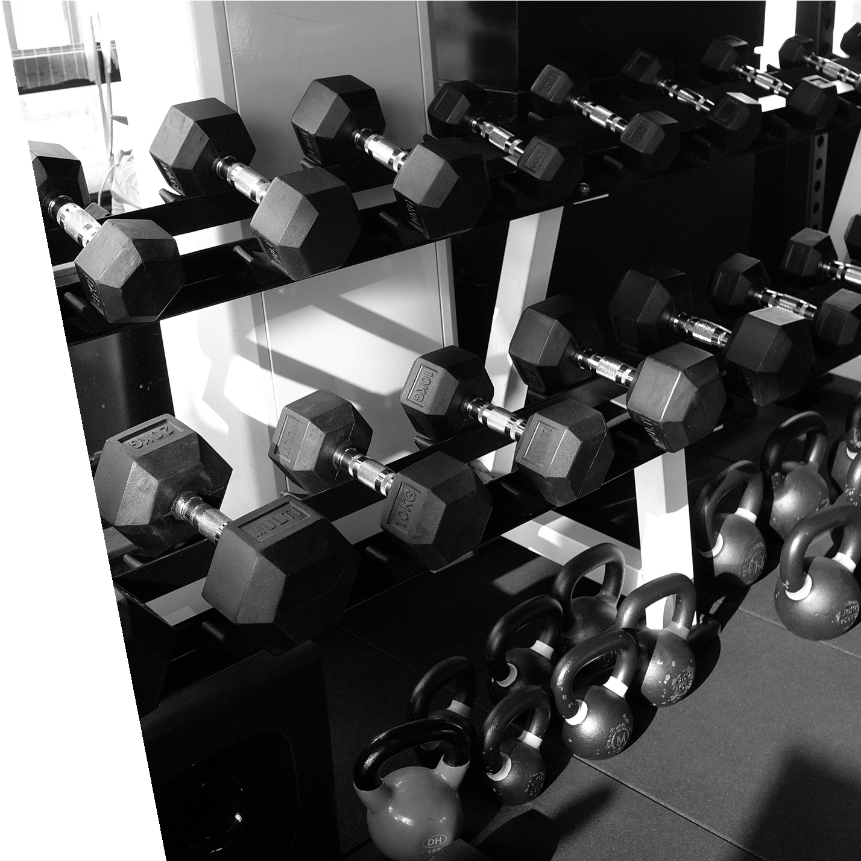
THANK YOU
BORCELLE
Kousik AP22110011364
Shiva Kumar
Keerthan
Somashekar
Sukesh
AP22110011344 AP22110011363 AP22110011347 AP22110011366

